Slide 1
Husky Connect
Dahira, Sally, Kaiyang, Dexin, Archita - INFO 380 AA7

Slide 2
Table of contents
01
03
Problem Space
Adoption strategy
02
04
Solution Overview
Solution Roadmap

Slide 3
Key Research Findings
“loyal alumni can…offer personal recommendations to help build enrollments, participate in alumni functions, purchase university-branded products, and enroll in professional education courses” (Koenig)
“generational changes, combined with the dominance of social and mobile technology, are changing the expectations of both advancement professionals and alumni with regard to the communications channels and demands for personalization” (Thayer, 2021)
“...LinkedIn is a very professional platform, so you only see the side of people that they're showing…their work side. Something Alumni 1 mentioned in one of the previous answers was aiming to have some sort of an informal engagement on this platform” (Alumni System Example Interview Transcript, 2022)
“...away from a transactional approach…to an ongoing relationship. What might be exchanged is not just money, but also expertise, connections and networks, with a growing recognition of the life cycle aspect of the relationship and the student journey from recruit through alumni and lifelong interaction” (Thayer, 2021)

Slide 4
Current State
Most college students hope to find a satisfying job after graduation
Having a platform specifically for strengthening our alumni network is necessary
Alumni resources are not only important to students and alumni
When it comes to alumni relationships, most people are willing to moving to an ongoing relationship
Strong need in the community for a platform that makes it easy to find and connect with alumni from a university

Slide 5
Key Stakeholders and Users
Alumni
University partners and employers
University Leadership
Student Advisors
Affiliate and advancement leadership
Current students

Slide 6
Our Solution
Purpose:
create an easy to use platform that makes it easier for alumni to stay connected with their university upon graduating and provides a built-in means of communication between students and alumni
Benefits:
Users can connect with one another immediately through our live chat
Users can reach offline users through the mailbox
Alumni can indicate interest in events and mark their availability
Users can book alumni that are of interest to them
Users can filter alumni by a variety of factors (company, major, etc.)

Slide 7
Adoption Strategy
Put links to the system on MyUW
Advertise on University of Washington homepage
Notify graduating seniors about signing up on Husky Connect during the last 3 months of their last year at school
Send an email every year to remind alumni to update their information.
Introduce the system to companies to help them identify the alumni working in their companies or discover potential employees
Host events in real life to help alumni and students connect with each other and get to know the system
A newsletter feature that will show current students what alumni are doing recently and encourage them to connect with alumni through the system

Slide 8
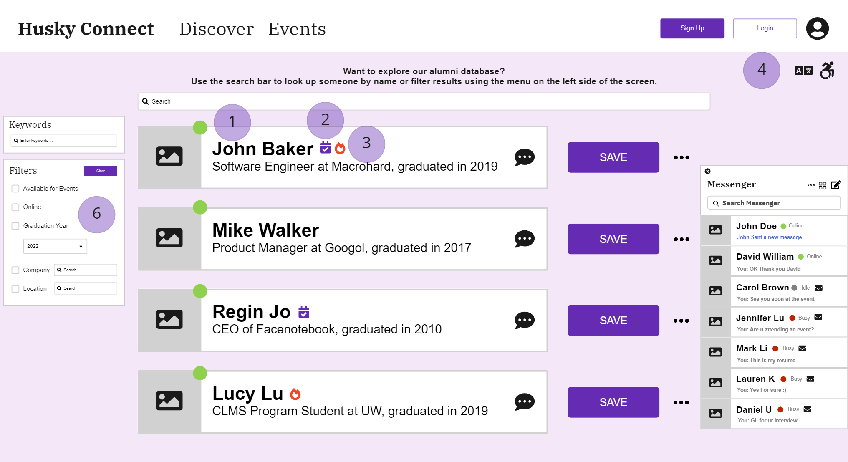

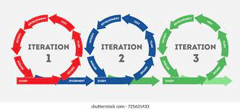

Solution Roadmap
Basic System (Login, Roles, Search)
Iteration
Reflect Feedback
Husky Connect Release

Slide 9
Thank you
Any questions?

